Slide 1
Responsible AI Testing Environment - RAITE
The Reproducibility Tool
Alain Joseph Boulay Submission to the TensorFlow Responsible AI Hackathon

Slide 2
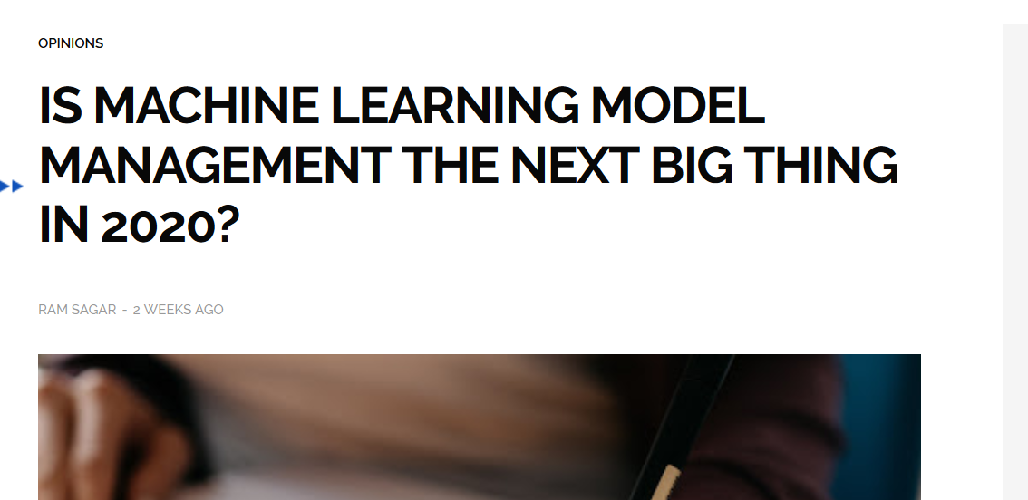
Is

Slide 3
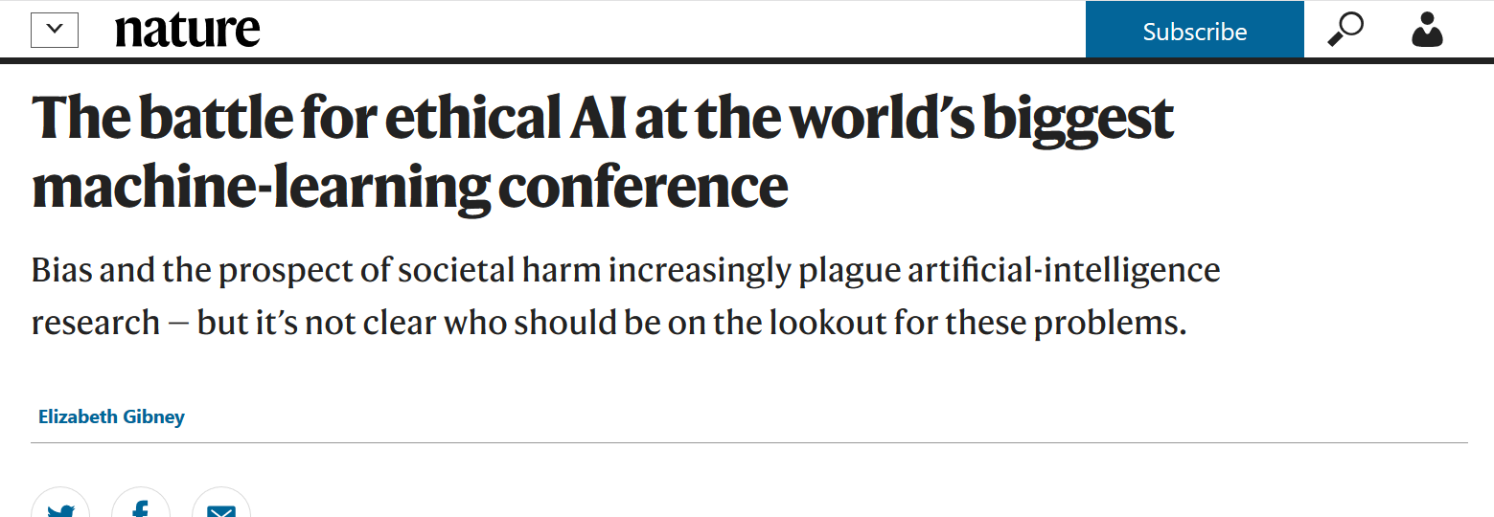

Slide 4
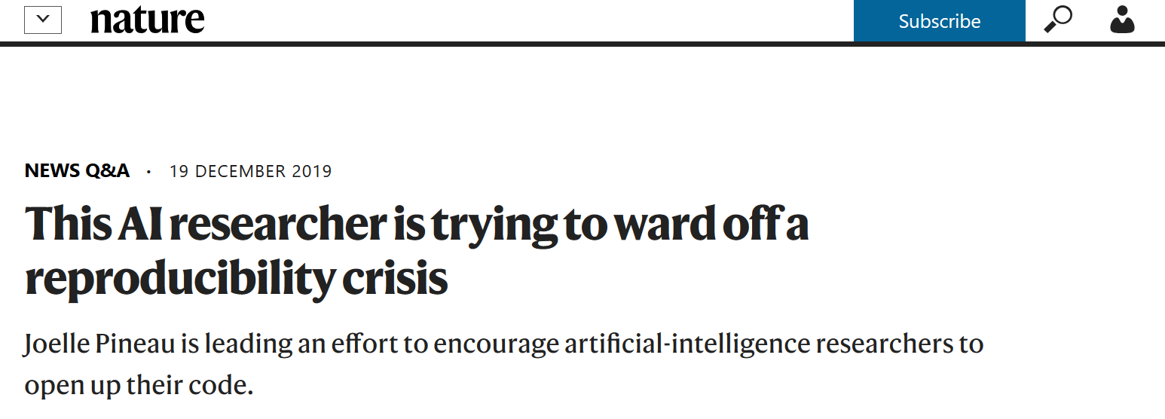

Slide 5
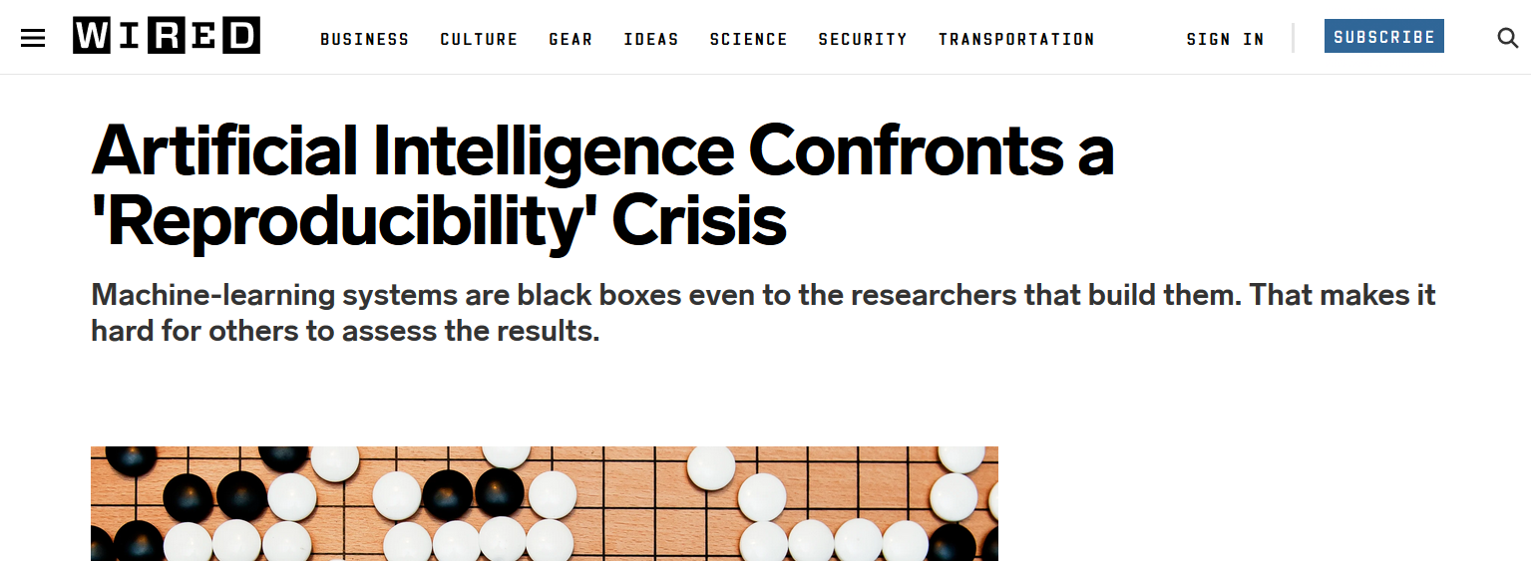

Slide 6
What is RAITE?
The Responsible AI Testing Environment (RAITE) is a collection of interactive tools and workflows that will help ML developers to design and code high quality ML applications that will also improve Responsible AI implementations. Our first tool in this toolbox is the Reproducibility Tool that ensures that others will be able to reproduce your ML code and ML results and improve Responsible AI. Reproducibility and improved design of ML experiments help improve Responsible AI by making sure that any Bias, lack of Fairness, lack of Transparency or poor Interpretability is caused for reasons other than poor Design of ML Experiments/Development.

Slide 7
Responsibility Tool
The Responsibility Tool was created based on two sources:
The TensorFlow ‘What If’ suite of tools.
The NeurIPS Reproducibility Challenge Checklist
The app displays live code in an editable CoLab or Notebook windows on the left of the interface. On the right of the interface is the NeurIPS Reproducibility Checklist. Developers can add code and text to their live document while using the Responsibility Checklist as a guide. By following the guide and inserting Reproducibility code into your own code, you can improve the quality of your ML app and avoid errors leading to poor Responsible AI.

Slide 8
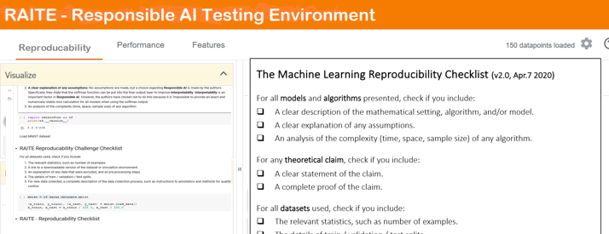

Slide 9
Summary
RAITE is built with TensorFlow 2.2
RAITE is designed to improve Responsible AI by improving the quality of ML
RAITE will be used to improve Responsible AI in ML research and Industrial ML applications.
RAITE will be used where new government policies and regulations require that benchmarks must be met by commercial suppliers of AI.
The Reproducibility Tool in RAITE will serve those who want their ML applications to meet top guidelines such as those put forth by NeurlPS and also want to improve Responsible AI.

Slide 10
Questions and Contact
Please contact
Alain Joseph Boulay
baj54403@gmail.com
With any questions about RAITE or the Reproducibility Tool for Responsible AI.
Thanks!!

